Slide 1

Data Analysis 2 Term project
Anna Grigoryan
Monika Molnar

Slide 2

The relationship between NBA players’ performance and their height
The National Basketball Association (NBA) is a men's professional basketball league in North America.
Taller players are thought to have an advantage because:
- their shots have less distance to travel to the basket,
- they start out closer to the rebound,
- they have a better chance of blocking shorter players' shots.
Tall athletes are over-represented in basketball.
Average height for an adult male over age 20 in the United States is 175.7 centimeters (measured 2011 - 2014).
The average height in our dataset is 197.4 centimeters (2014-2015 season).

Slide 3
Our Data
Source:
Kaggle 2014-2015 season of NBA
Scraped from ’Advanced Stats’ page of the official NBA website
Preparing:
Cleaned data in R
Dropped NA’s
Content:
422 observations and 34 features
Features of interest: Height, Age, BMI, Points (PTS), Efficiency Rating (EFF), Position (Pos)
Efficiency rating = (Points + Rebounds + Assists + Steals + Blocks - (Field Goals Attempted - Field Goals Made) + (Free Throws Attempted - Free Throws Made) + Turnovers)

Slide 4
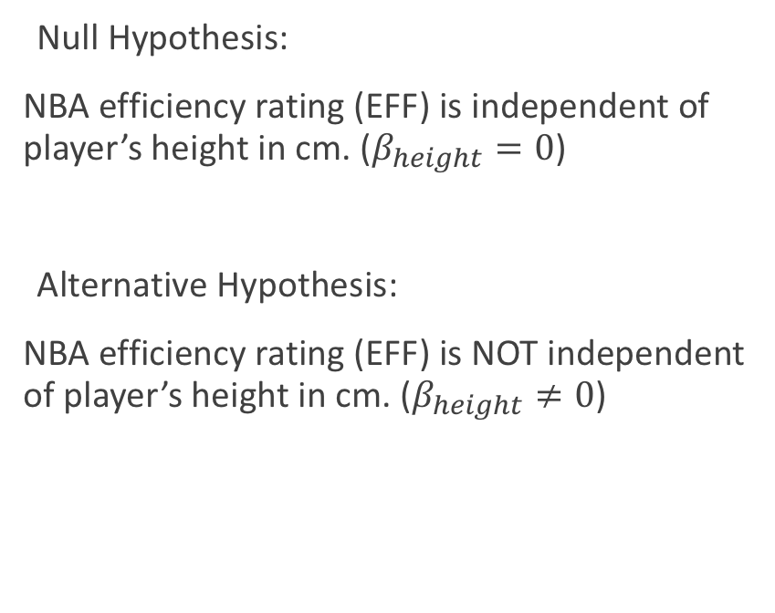
Formulating the Hypothesis
Null Hypothesis:
NBA efficiency rating (EFF) is independent of player’s height in cm. ($β_{height}=0$)
Alternative Hypothesis:
NBA efficiency rating (EFF) is NOT independent of player’s height in cm. ($β_{height}≠0$)

Slide 5
Modeling
Independent variable: Height (player’s height in cm)
Dependent variable: EFF( efficiency rating)
Control variable: season 2014-2015
Models:
Non-parametric loess regression
Linear regression with splines
Linear regression with quadratic polynomial

Slide 6
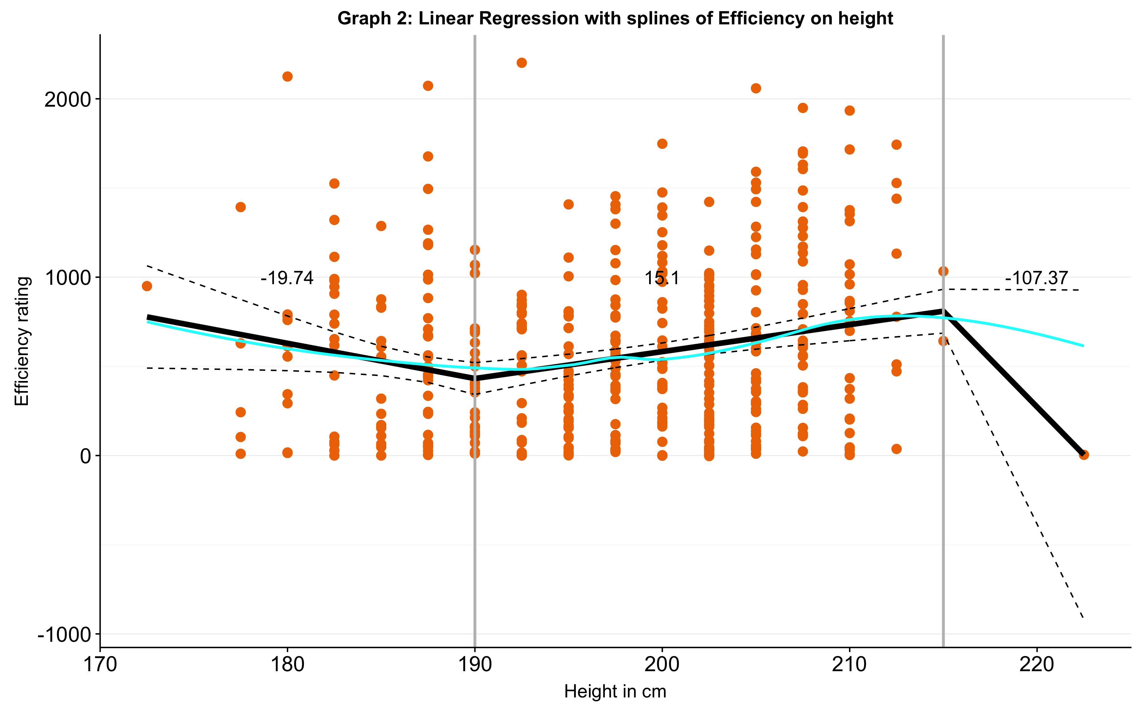
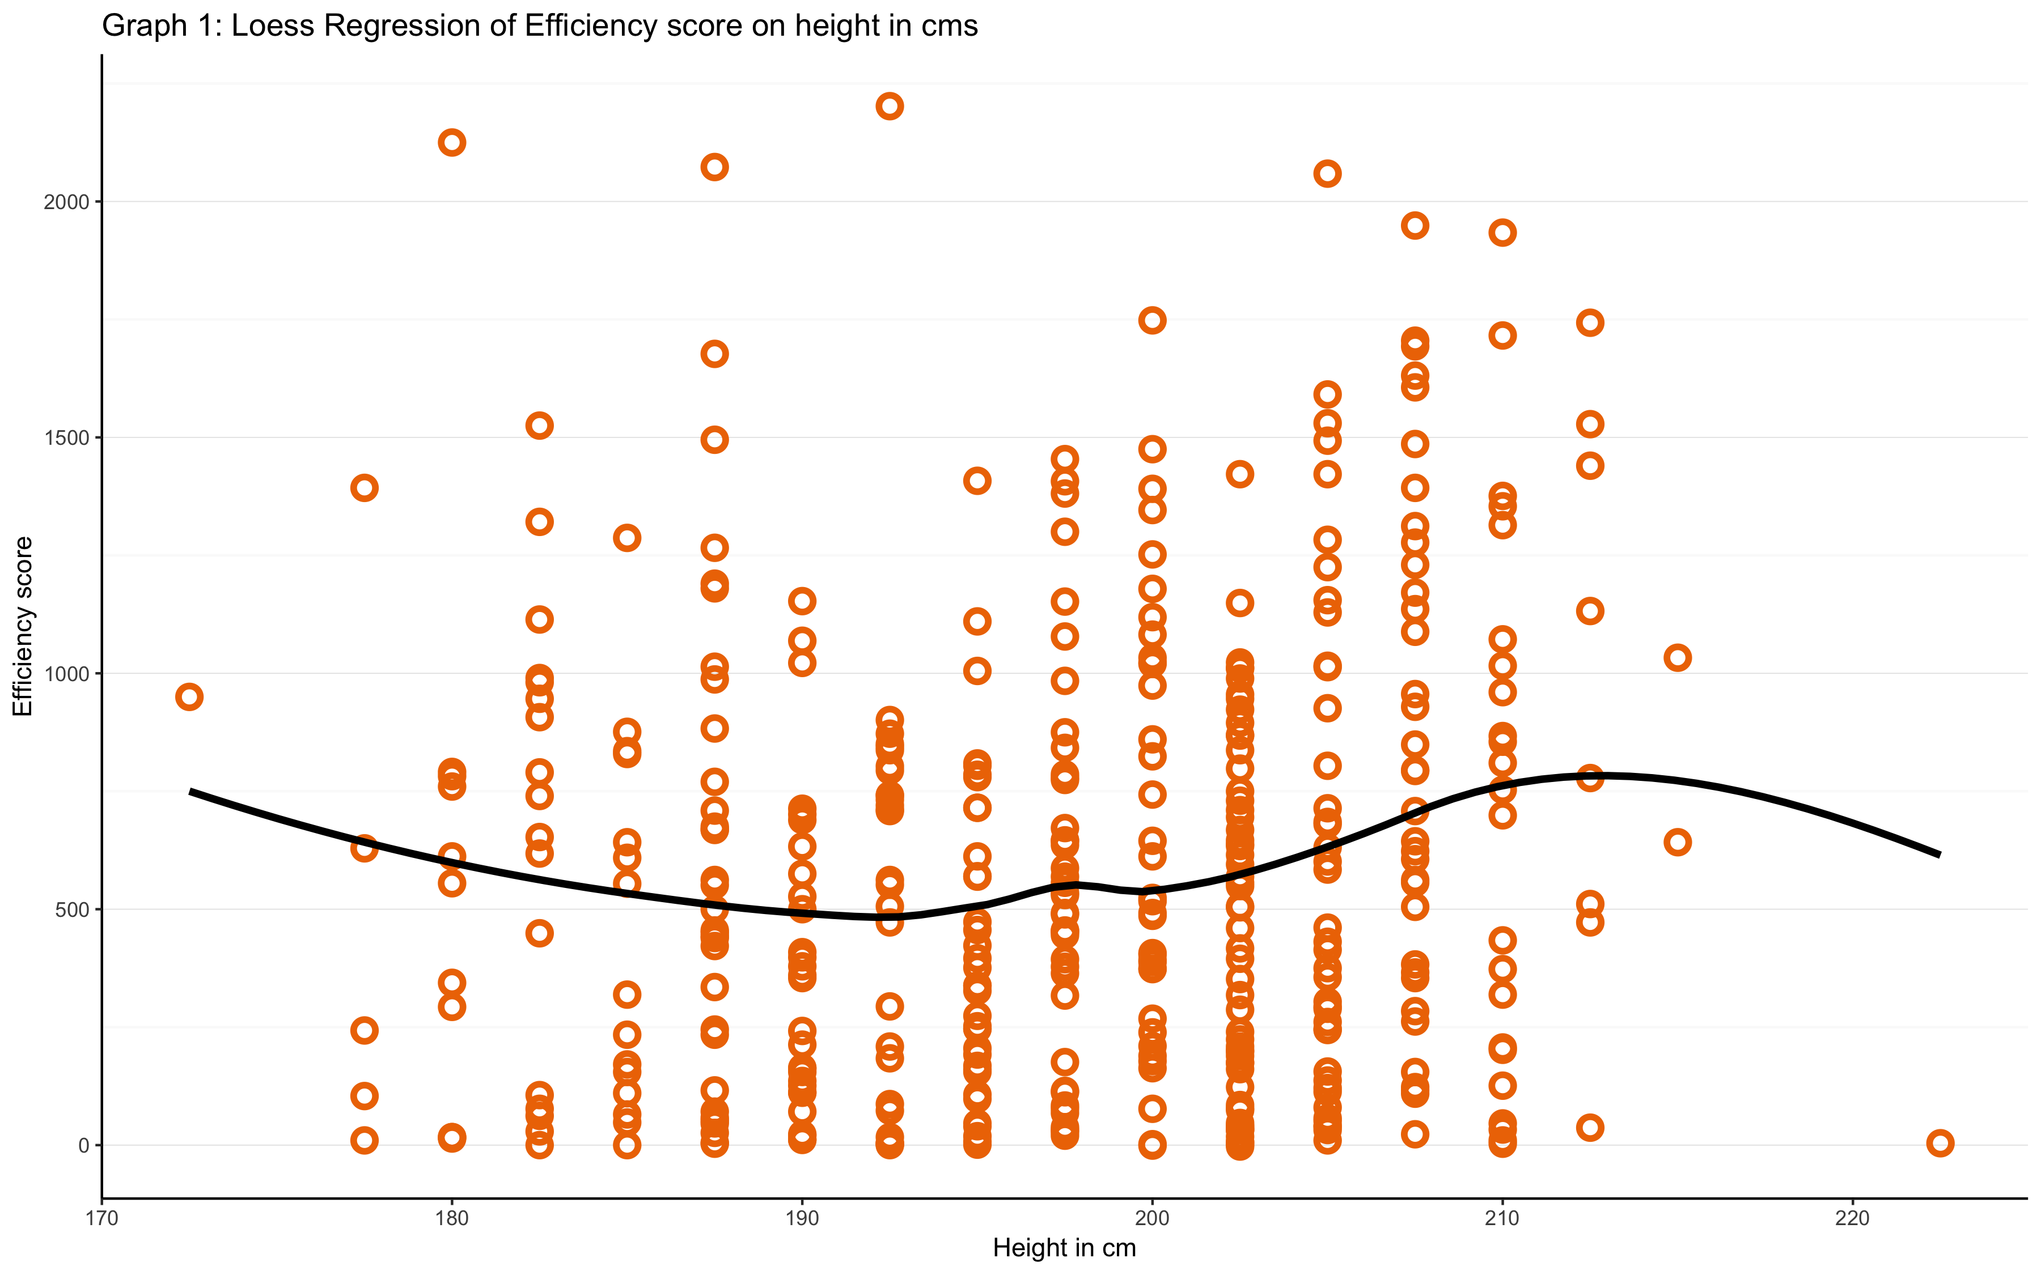
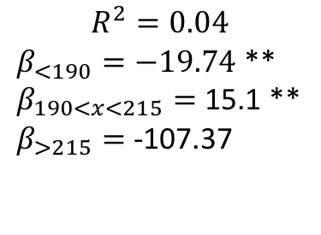
Loess regression of Efficiency score on capita
$$R^{2}=0.04$$
$β_{<190}=−19.74$ **
$β_{190<x<215}=$ 15.1 **
$β_{>215}=$ -107.37

Slide 7
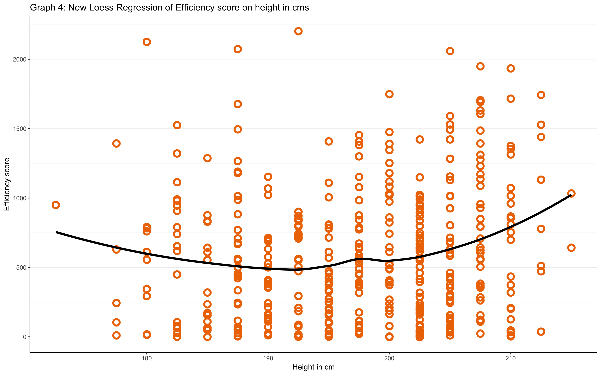
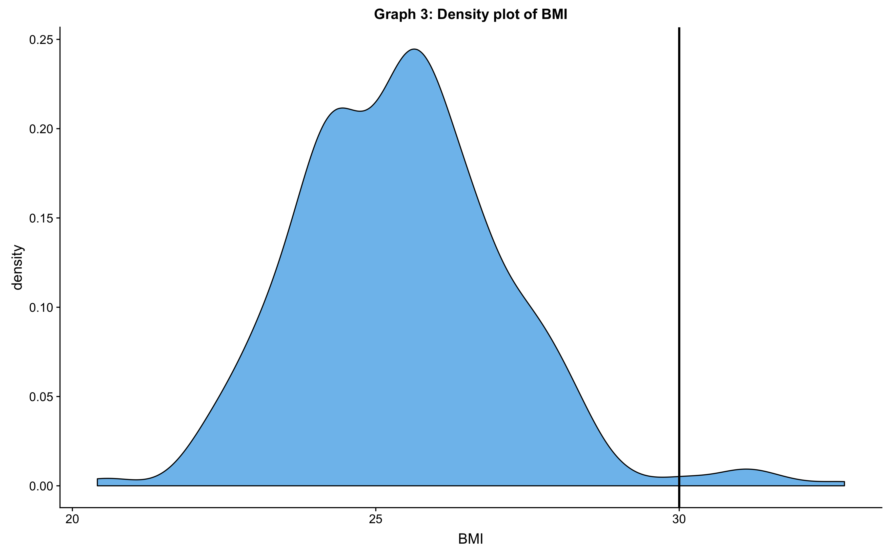
Controlling for more features…

Slide 8
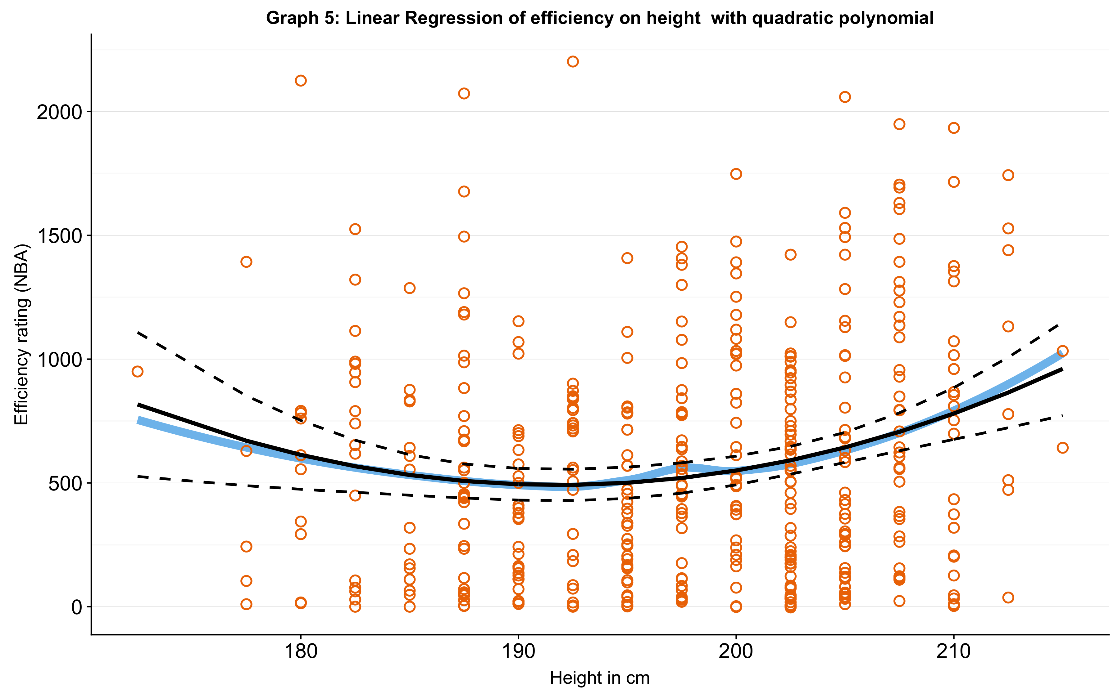
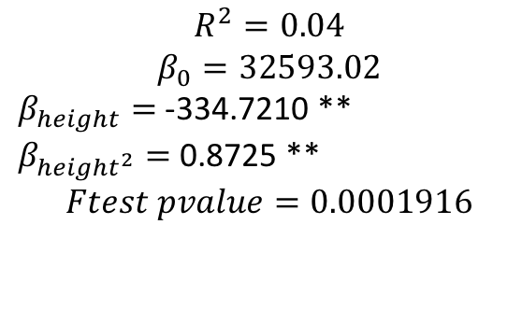
Linear regression with quadratic polynomial
$$R^{2}=0.04$$
$$β_{0}=32593.02$$
$β_{height}=$ -334.7210 **
$β_{{height}^{2}}=$ 0.8725 **
$$Ftest pvalue=0.0001916$$

Slide 9
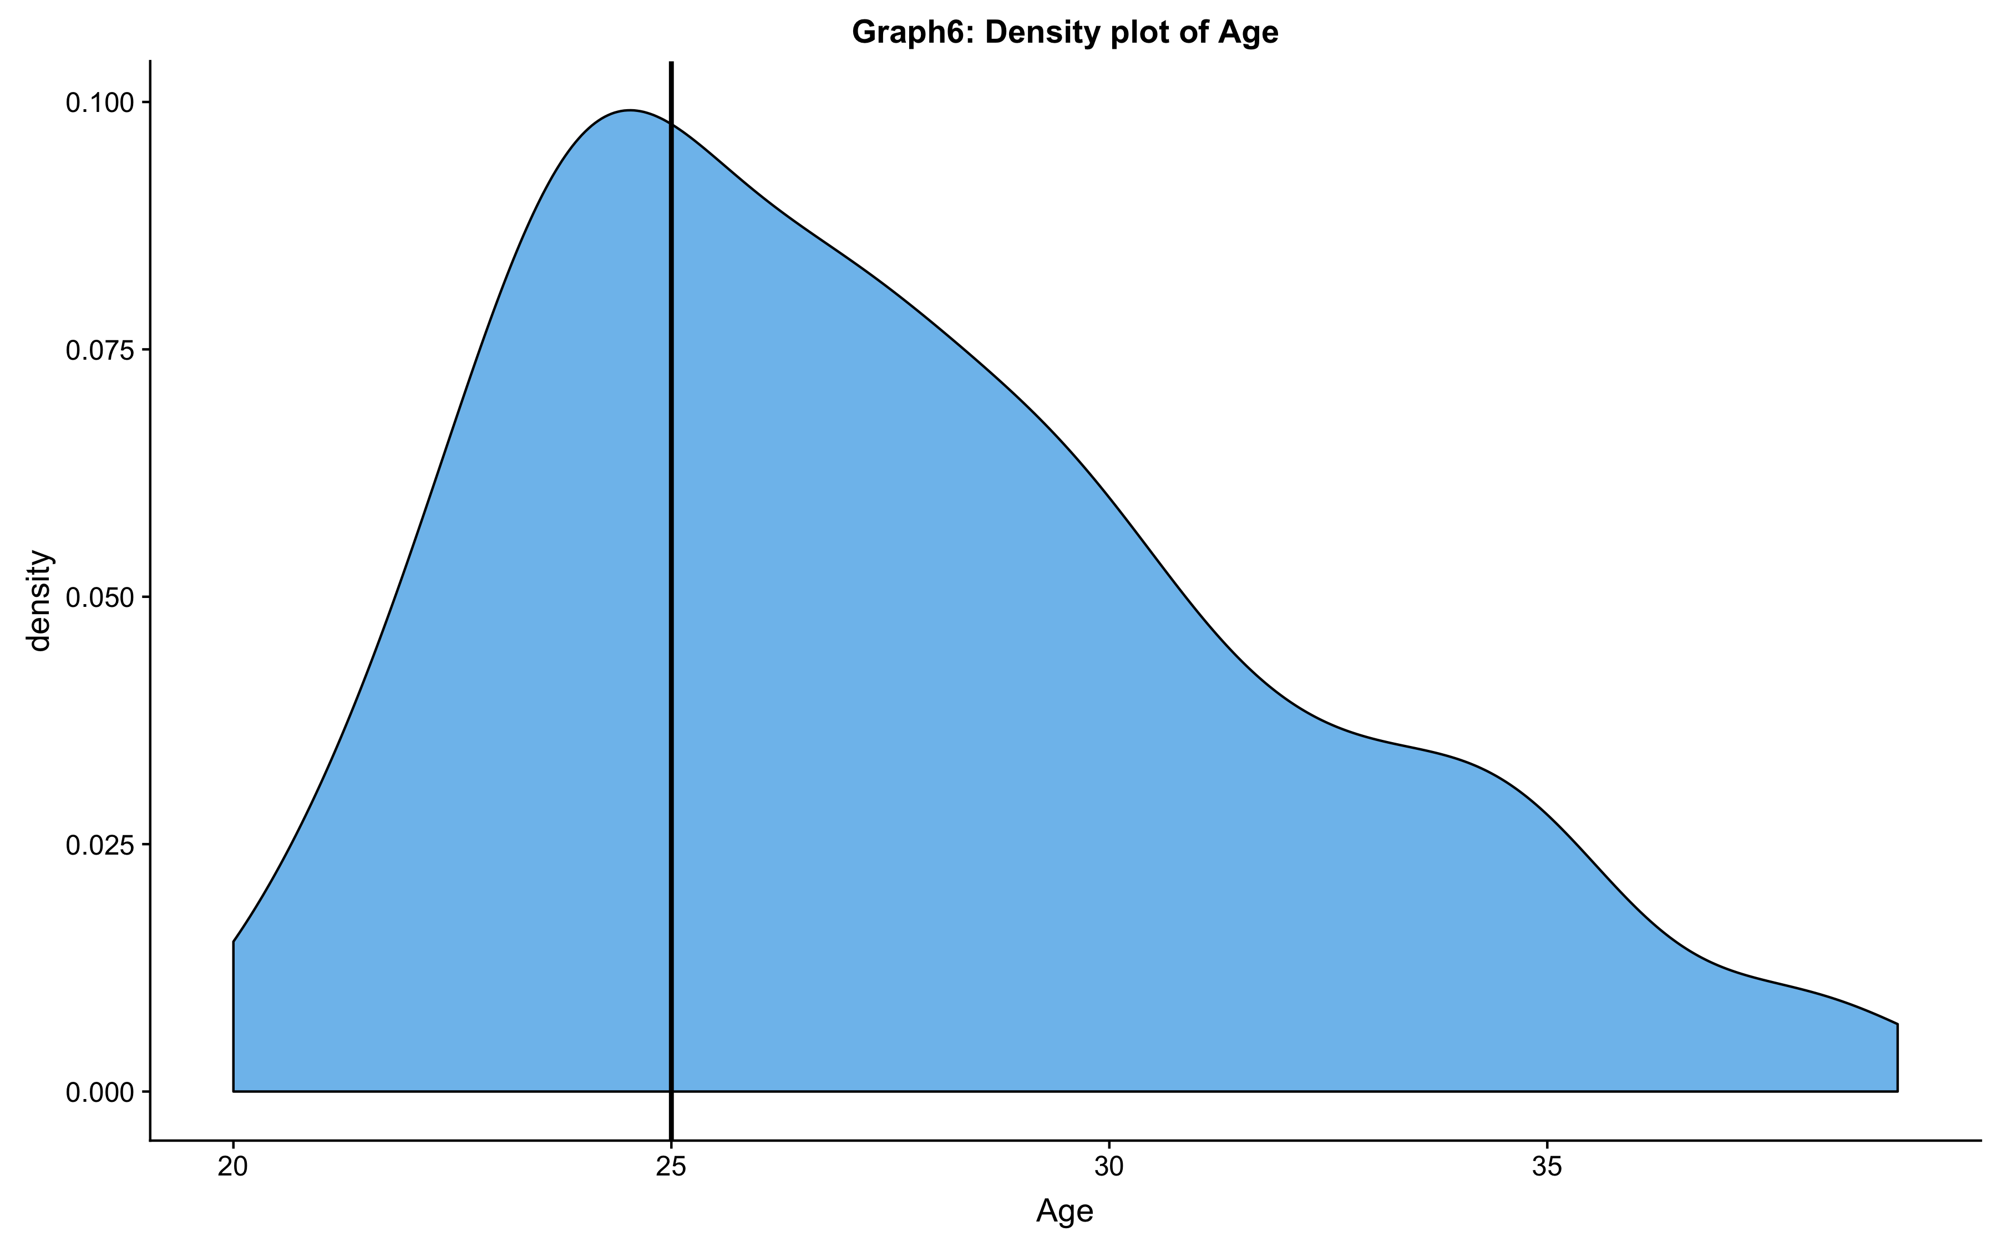
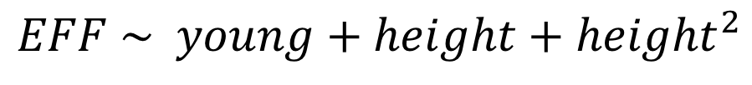
Multivariable regression
Independent variables:
Height (player’s height in cm),
Young (1 if Age<25, else 0)
Dependent variable: EFF( efficiency rating)
Control variable: season 2014-2015, BMI <30
$$EFF \sim young+height+{height}^{2}$$

Slide 10
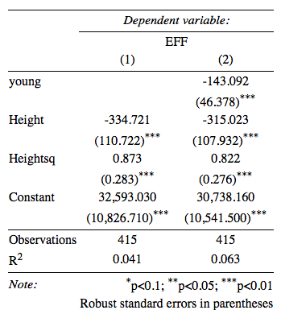
Results

Slide 11
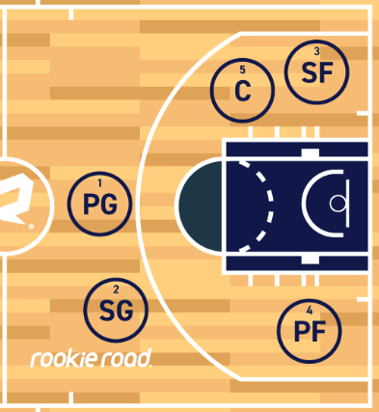
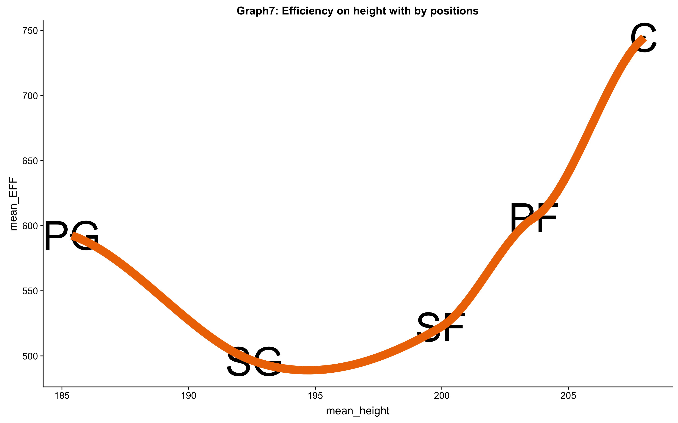
Efficiency by positions
5
4
1
3
2

Slide 12
Conclusion
Reject the Null hypothesis:
Efficiency score is not independent of average height at alfa=0.05, controlling for the season (14-15) and BMI.
Age is another significant factor in EFF ratings.
The heights are significantly different across the playing positions.
(ANOVA test, p-value<2e-16)

Slide 13

Questions?

Slide 14

Thank you for your attention!
Anna Grigoryan
Monika Molnar

